Slide 1


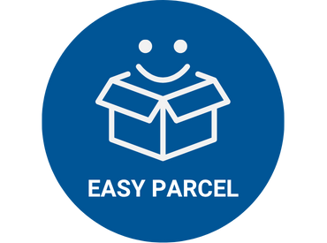
FYP VIVA
Easy Parcel: IoT-Based Parcel Storage System for University Villages
Presented by:
Muhammad Afiq bin Zakaria
21001351
Bachelor of Computer Science (Hons)
Presented to:
AP Dr M Anuaruddin Ahmadon
Mr. Aznan Mohd
Supervisor:
Dr Siti Nurlaili bt Karim
24.11.2025 (Monday)
Notes:
Assalamualaikum and good evening to the panel Dr Nurlaili and Dr Luqman. My name is Muhammad Afiq bin Zakaria, and I will be presenting my Final Year Project proposal, titled 'Easy Parcel: IoT-Based Parcel Storage System for University Villages

Slide 2

AGENDA
03
Introduction
08
Literature Review
14
Methodology
14
Result & Discussion
21
Conclusion & Future Works
Notes:
This is the agenda of my presentation. I will start with an introduction, which include the background of study, problem statement, project objectives, and scope of study. Then, I will share the literature review, methodology, and finally, conclude with future work.

Slide 3

INTRODUCTION

Slide 4

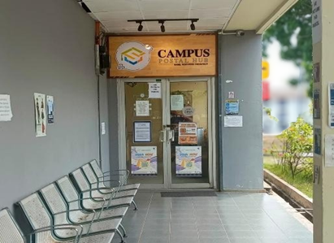

BACKGROUND OF STUDY
UTP Parcelhub
1
Malaysia E-commerce Growth
Malaysia’s e-commerce income reached RM918.2 billion in the first nine months of 2024, marking a 4.0% year-on-year growth
2
University Students Role in E-commerce
Tech-savvy, reliant on digital platforms, and attracted by convenience, discounts, and price comparisons.
Notes:
Online shopping has become a daily routine among university students, who often order food, clothing, electronics, and academic tools online. With this trend increasing, especially after the COVID-19 pandemic, universities are receiving hundreds of parcels each day. This demand creates the need for an efficient, secure, and accessible delivery system on campus.
Students prefer online shopping due to lower prices, convenience, and the ability to compare products easily. According to statistics, Malaysia’s e-commerce users are projected to exceed 18 million by 2029, indicating that parcel volume will continue to rise. This growing reliance on delivery services makes it crucial for universities to adopt modern solutions for parcel management.
To handle the high volume of deliveries, our university implemented ParcelHub—a centralized location for students to collect their parcels. ParcelHub ensures that parcels are stored in a secure environment and only released to verified students. It helps avoid parcel loss and misplacement.

Slide 5






PROBLEM STATEMENT
One centralized location (ParcelHub), far from most student residences
Long queues during peak hours
Inconvenient for students without transport
While the ParcelHub aims to simplify parcel collection, it still has notable flaws that impact student convenience.
Limited parking space for those who drive
Students must pay additional service fee to collect parcels
Notes:
Even though ParcelHub simplifies parcel handling, there are still several issues. First, there is only one centralized location, which is far from most student hostels. This causes long queues during peak hours. It’s also inconvenient for students without transport, and limited parking creates additional problems. Lastly, students must pay extra fees to collect their parcels, even after paying shipping fees

Slide 6

OBJECTIVES
To evaluate the usability and effectiveness of the Easy Parcel system through user testing and feedback from students and couriers.
To build a mobile application for both students and couriers to manage locker access and track deliveries.
01
02
03
04
To implement a random password lock system and barcode scanning for secure identification of parcel senders (couriers) and receivers (students).
To design and develop an IoT-based smart locker system for student villages to store small parcels securely
Notes:
This project has three main objectives:

Slide 7
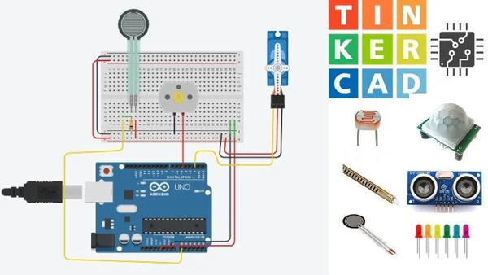


SCOPE OF STUDY
Design and develop a smart locker prototype using microcontrollers, sensors, and electronic locks.
Tinkercad will be used to simulate the circuit design before building the hardware.
Develop a mobile app using Flutter for students and couriers to access lockers and track parcels.
Data will be managed using Firebase Firestore.
Implement secure OTP-based access using Supabase Authentication.
Manage real-time parcel records and barcode data using the Supabase (PostgreSQL) database.
Notes:
The scope of this project is divided into three main areas based on the objectives: hardware development, mobile application development, and integration of authentication and identification features.
For the hardware, I will use the Arduino Uno R3 as the microcontroller. Before building the actual locker system physically, I will simulate the circuit using Tinkercad to test its design and functionality. This helps reduce the risk of hardware errors and allows me to plan the connections for components like servo motors, keypads, and sensors more effectively.
Next, for the mobile application, I will use Flutter to develop a user-friendly interface that works on both Android and iOS. The app will have two different user roles: students and couriers. It will connect to Firebase Firestore to allow real-time data access and syncing between the app and the smart locker system.
Lastly, I will Implement OTP-based access using Firebase Authentication.I also will Integrate barcode scanning to log parcel sender and receiver details, with records stored in the cloud.

Slide 8
LITERATURE REVIEW

Slide 9





RELATED WORKS
Mobile Apps for IoT
User-centric mobile interfaces are crucial for controlling and monitoring IoT devices remotely .
Security & Auth
Lightweight authentication mechanisms (like OTPs) are essential for resource-constrained IoT devices
IoT in Smart Systems
IoT is the "cornerstone" of modern automation, improving efficiency and reducing human intervention .
Soori et al. (2023); Kunwar (2024)
Soori et al. (2023); Kunwar (2024)
01
02
03
04
05
Soori et al. (2023); Kunwar (2024)
Smart Locker Systems
Dual authentication (biometrics + OTP) is highly secure but complex. Low-cost barcode lockers reduce parcel loss .
Soori et al. (2023); Kunwar (2024)
Cloud Databases
Cloud computing enables real-time data synchronization and scalable storage for IoT devices .
Soori et al. (2023); Kunwar (2024)
Notes:
In this section, I will present findings from related research and existing solutions. I reviewed several academic papers and projects to understand how smart locker systems and parcel handling solutions are currently being developed.
I will focus on three key aspects for comparison:
-The technologies used
-The purpose or target users of the system
-The features offered, including security mechanisms, user interface, and cost-efficiency.
By analyzing these aspects, I aim to highlight the gaps in previous work and show how my project is designed to meet the specific needs of university students living in residential villages.

Slide 10











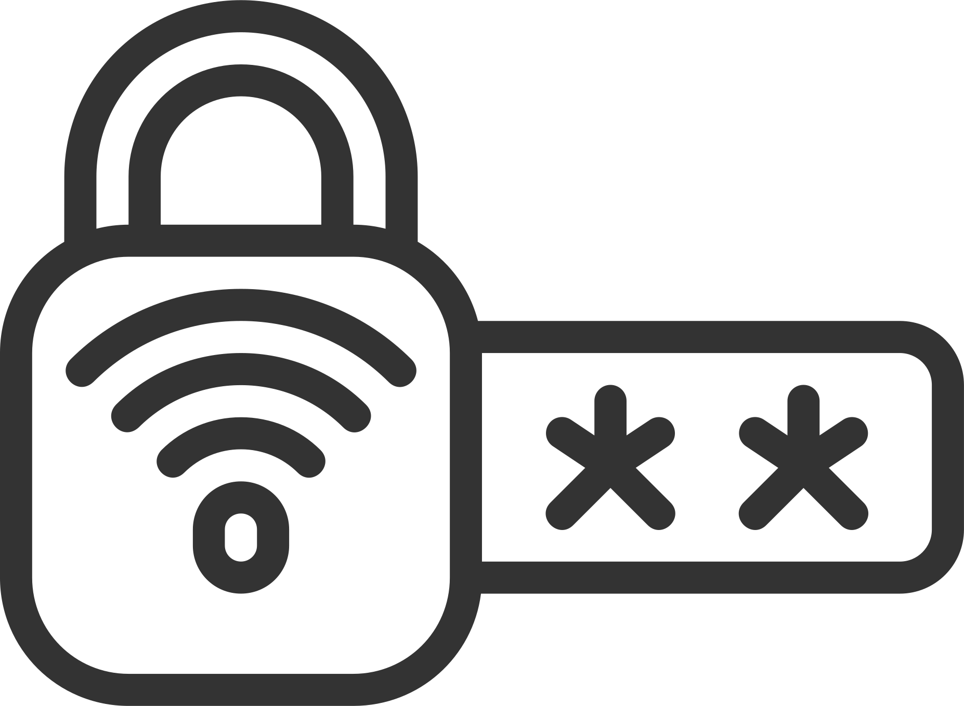

THEORETICAL FRAMEWORK
The foundation for connecting physical devices (lockers) to the internet for automation and real-time monitoring.
Adopts a RESTful design where the Mobile App (Client) communicates via HTTP requests with the ESP32 and Database (Servers).
Internet of Things (IoT)
1
Client-Server Architecture
3
Cloud Computing
2
Authentication (OTP)
4
Uses cloud backend services (Supabase) to manage data scalability and reduce the need for complex local servers.
Implements One-Time Passwords as a time-sensitive security mechanism to prevent unauthorized access.
Notes:
In this section, I will present findings from related research and existing solutions. I reviewed several academic papers and projects to understand how smart locker systems and parcel handling solutions are currently being developed.
I will focus on three key aspects for comparison:
-The technologies used
-The purpose or target users of the system
-The features offered, including security mechanisms, user interface, and cost-efficiency.
By analyzing these aspects, I aim to highlight the gaps in previous work and show how my project is designed to meet the specific needs of university students living in residential villages.

Slide 11



RESEARCH GAPS & SOLUTIONS
1
Cost & Complexity:
Existing solutions often rely on expensive hardware like facial recognition or proprietary cloud systems, making them unsuitable for budget-constrained campuses.
Uses affordable components (ESP32, Keypad) instead of biometric scanners.
Low-Cost
Designed to be placed at the residential blocks, not a central hub.
Decentralized
Centralization Issues: Current campus solutions (like ParcelHub) are centralized, causing congestion and accessibility issues for students living in distributed villages.
Leverages Supabase and Flutter for a cost-effective, scalable infrastructure.
3
Open Source
Notes:
From the literature reviewed, I have identified several specific gaps that my project intends to address:

Slide 12
METHODOLOGY

Slide 13
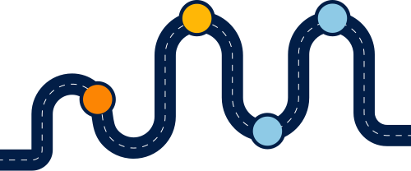
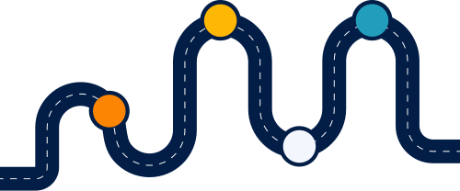



METHODOLOGY
Hardware Assembly & Testing
DATABASE INTEGRATION
Hardware Design & Simulation
MOBILE APP DEVELOPMENT
SYSTEM INTEGRATION
Notes:
The hardware part of this project focuses on designing a working prototype of the smart parcel locker using Arduino Uno R3 as the main controller. I chose Arduino because it is widely used, cost-effective, and easy to program, especially for prototyping small embedded systems.
To begin the development process, I will first design and simulate the circuit in Tinkercad. Tinkercad allows me to visualize and test the connections between components such as servo motors, keypads, LCD displays, and sensors in a virtual environment. This step is crucial to ensure that the components behave as expected before moving on to physical implementation. It also helps reduce hardware damage or wiring errors during testing.
Once the simulation is complete and confirmed to be working, I will proceed to build the physical model. This step-by-step process ensures a smooth transition from design to implementation, minimizing errors and rework.

Slide 14


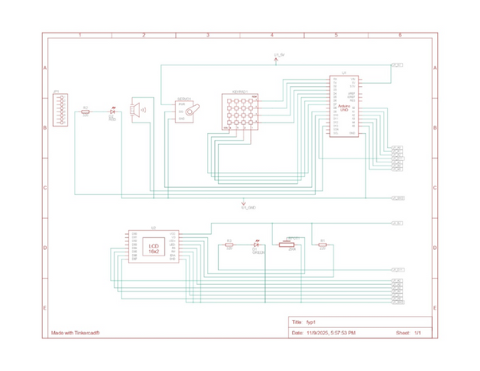
HARDWARE DESIGN & SIMULATION
Virtual Prototyping
Arduino Proxy
Designed and simulated the circuit in Tinkercad to ensure connection safety.
Used an Arduino UNO for simulation as Tinkercad lacks ESP32 components.
Schematic Diagram
Validation
Figure 3.9 (Hardware Schematic Diagram).
Verified core interactions for the keypad, LCD, and servo before physical assembly
Notes:
The hardware part of this project focuses on designing a working prototype of the smart parcel locker using Arduino Uno R3 as the main controller. I chose Arduino because it is widely used, cost-effective, and easy to program, especially for prototyping small embedded systems.
To begin the development process, I will first design and simulate the circuit in Tinkercad. Tinkercad allows me to visualize and test the connections between components such as servo motors, keypads, LCD displays, and sensors in a virtual environment. This step is crucial to ensure that the components behave as expected before moving on to physical implementation. It also helps reduce hardware damage or wiring errors during testing.
Once the simulation is complete and confirmed to be working, I will proceed to build the physical model. This step-by-step process ensures a smooth transition from design to implementation, minimizing errors and rework.

Slide 15
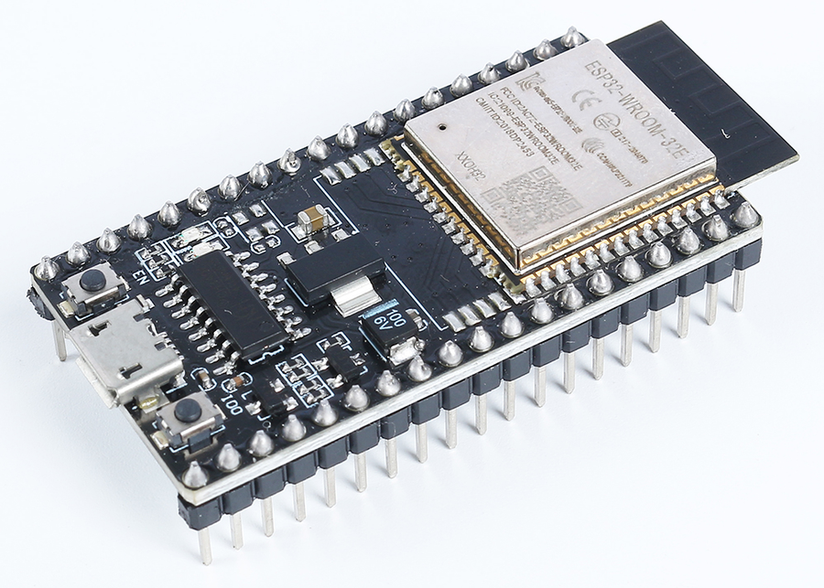
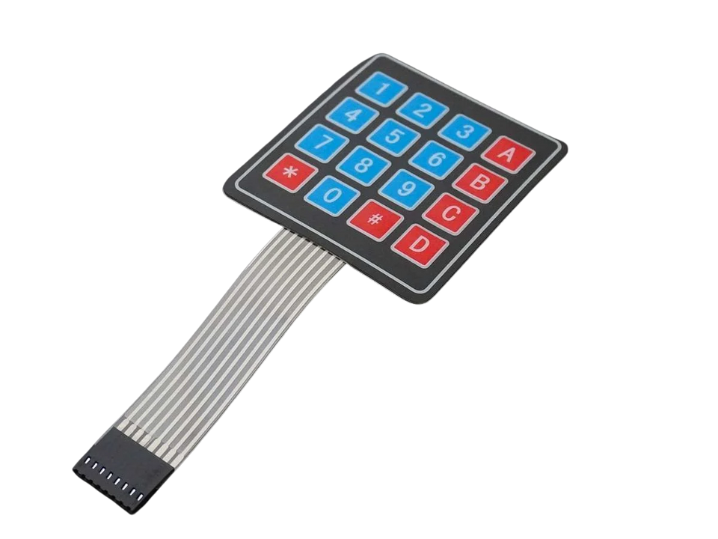
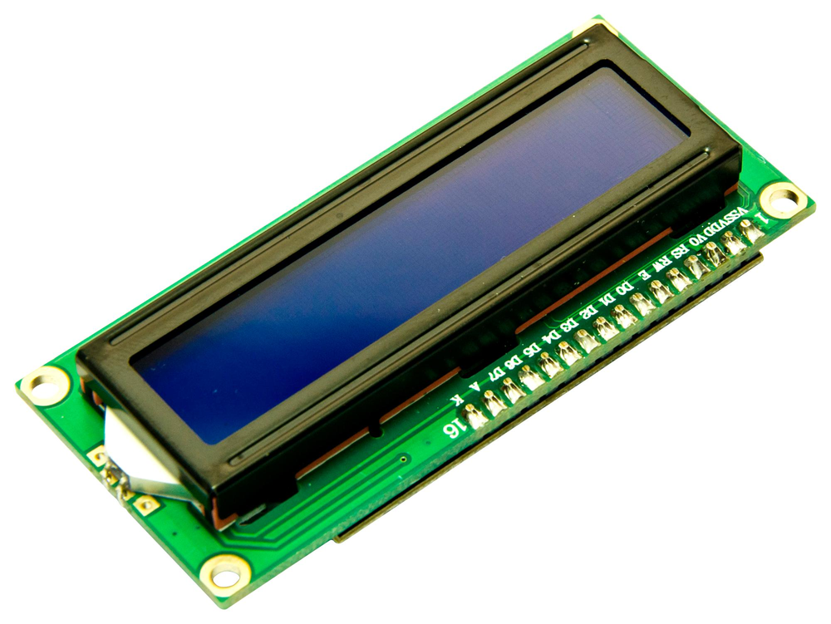
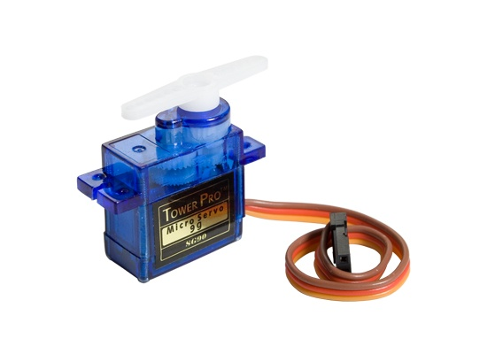
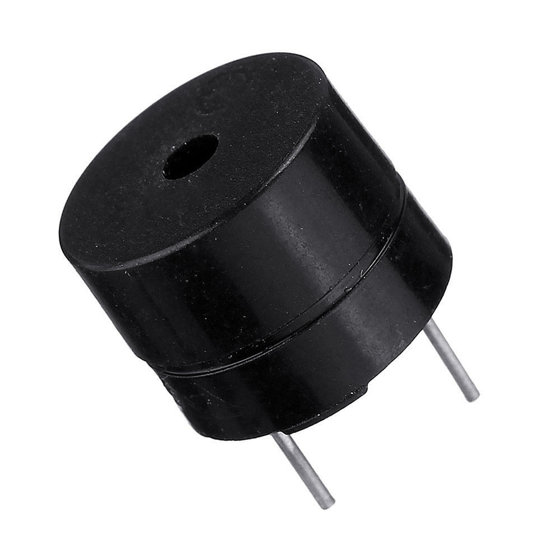
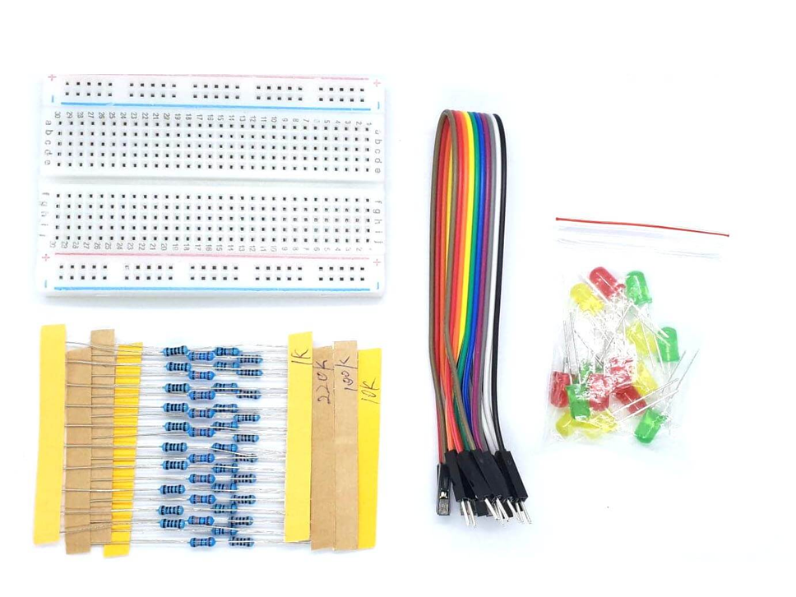
HARDWARE COMPONENTS
1
ESP32
2
Keypad
3
I2C LCD
Main microcontroller for controlling inputs and outputs.
To allow manual entry of OTP or password.
To display status messages or OTP confirmations.
4
Servo Motor
5
Buzzer
6
Other Components
To open and close the locker door electronically.
To provide audible feedback (e.g., when access is granted or denied).
For circuit connections and LEDs for showing state
Notes:
These are the main components I plan to use:

Slide 16
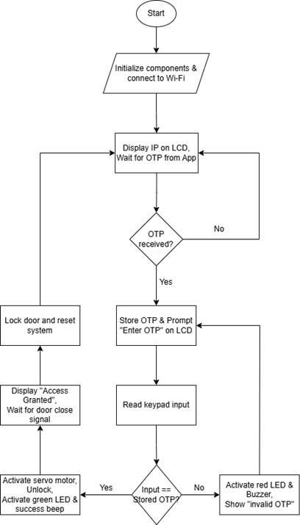




HARDWARE ASSEMBLY & TESTING
1
Coding
Programmed the ESP32 in C++ using the Arduino IDE and standard libraries.
2
Connectivity
Created a Web Server to process app requests and verify OTPs.
3
Wireless Updates
Included Over-the-Air (OTA) support for wireless code uploads.
Notes:
The hardware part of this project focuses on designing a working prototype of the smart parcel locker using Arduino Uno R3 as the main controller. I chose Arduino because it is widely used, cost-effective, and easy to program, especially for prototyping small embedded systems.
To begin the development process, I will first design and simulate the circuit in Tinkercad. Tinkercad allows me to visualize and test the connections between components such as servo motors, keypads, LCD displays, and sensors in a virtual environment. This step is crucial to ensure that the components behave as expected before moving on to physical implementation. It also helps reduce hardware damage or wiring errors during testing.
Once the simulation is complete and confirmed to be working, I will proceed to build the physical model. This step-by-step process ensures a smooth transition from design to implementation, minimizing errors and rework.

Slide 17


MOBILE APP DEVELOPMENT
Development Environment
IoT Communication
01
Built using the Flutter framework and coded in VS Code for cross-platform compatibility.
05
ESP32Service class manages HTTP requests to send OTPs and check locker status.
Unified Entry Point
Parcel Processing
02
Single LoginScreen handles both authentication and registration with a toggle for "Sign Up" or "Login".
06
Courier module auto-generates a unique OTP and Barcode for every new parcel delivery.
Role-Based Logic
Dual-Input System
03
Implements distinct navigation paths for Students (pickup) and Couriers (delivery) upon login.
07
Couriers can input recipient details manually or via QR Scanning for efficiency.
Dashboard Architecture
Verification Logic
04
Uses TabBarController to separate active tasks (Delivery/Pickup) from completed History.
08
Student app verifies collection by scanning the parcel's barcode, updating the status to "Collected".
Notes:
For the software part I will build the mobile app...
for the development process of the software, first thing I will do is UI design...

Slide 18

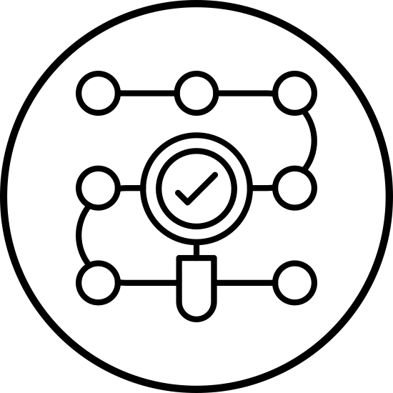


DATABASE INTEGRATION
Supabase
Backend
Integrated Supabase for real-time PostgreSQL database management
Syncing
Structure
Enabled real-time synchronization for instant parcel status updates.
Organized relational tables for Users, Parcels, and Lockers.
Notes:
This diagram shows the full system flow. It show the flow of

Slide 19
RESULTS & DISCUSSION

Slide 20
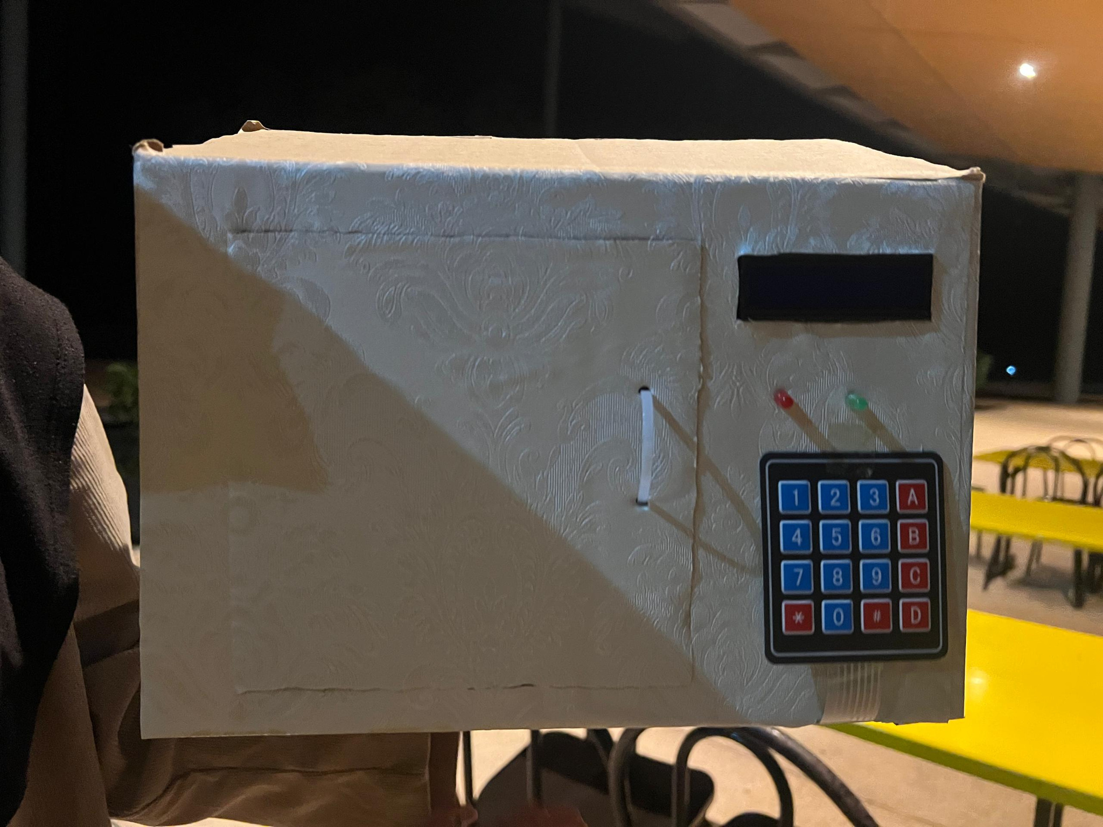
LOCKER PROTOTYPE
Buzzer
LCD
ESP32
Servo Motor
LEDs
Door and handle
Keypad

Slide 21
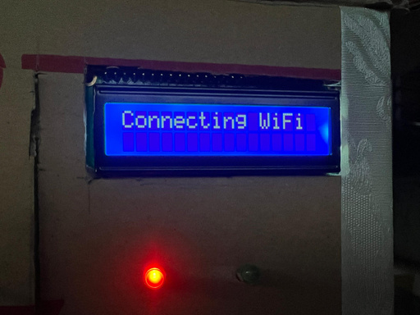
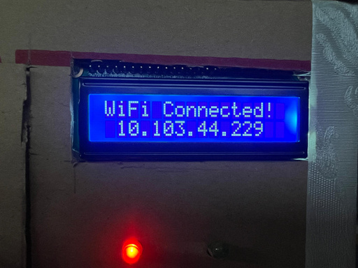
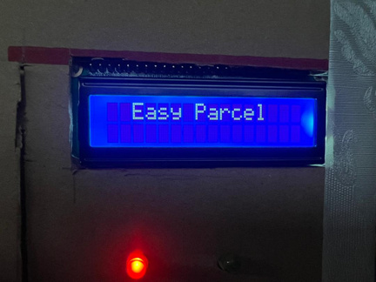
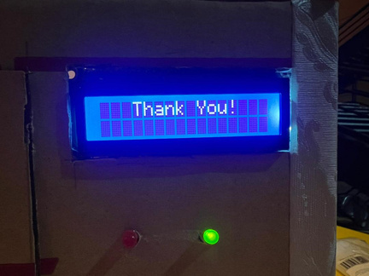
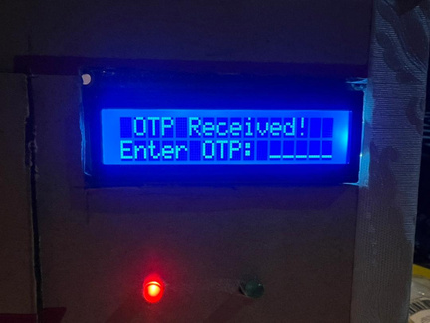
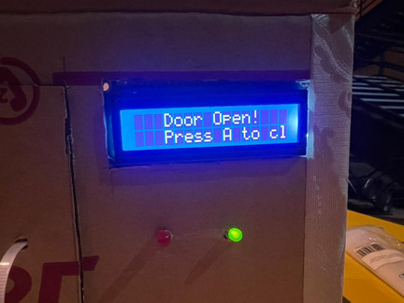
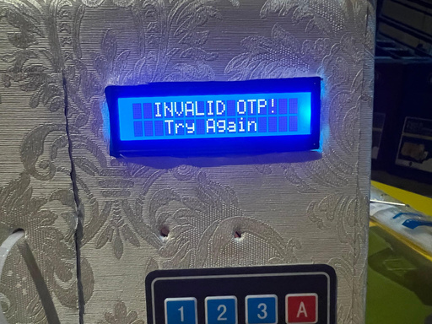
HARDWARE
Initial State
IP Adress displayed
Enter OTP
No
OTP Received?
Yes
OTP Correct?
Yes
Door open,
Collect parcel,
Press A to lock again
No

Slide 22
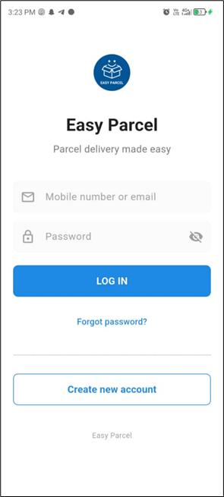
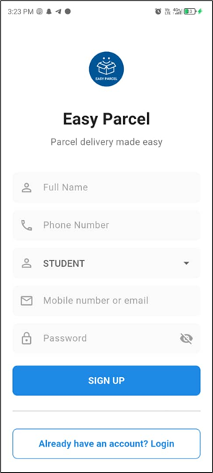

MOBILE APPLICATION
1
Login Screen
2
Register Screen
User-Friendly Access: Straightforward input fields for mobile number/email and password.
Essential Information Capture: Fields for Full Name, Phone Number, and Email/Mobile.
Security Features: Password visibility toggle for user convenience and security.
User Categorization:
"Student" dropdown to specify user type (e.g., for campus-specific services).
Password Creation:
Secure password field with visibility toggle.
Account Recovery: "Forgot password?" option to assist users.
Streamlined Signup:
Prominent "SIGN UP" button.
New User Onboarding: Clear "Create new account" button for easy registration access.
Click
Existing User Link:
"Already have an account? Login" for seamless navigation.

Slide 23
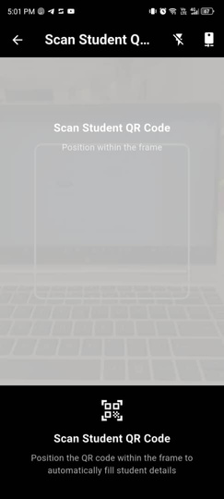
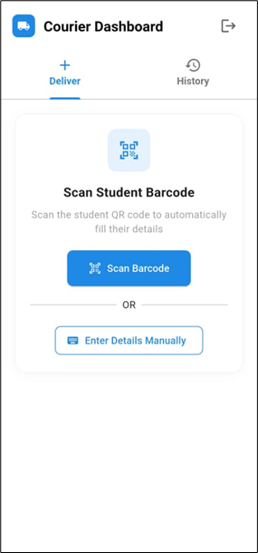
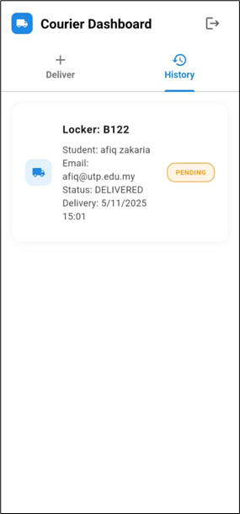
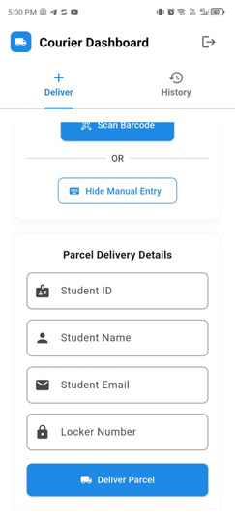
MOBILE APPLICATION
3
Courier Homescreen
3
Courier Homescreen:
History Tab
Dual Input Methods: Couriers can register a parcel by either scanning a student's QR/Barcode or entering details manually.
Delivery Log:
Provides a complete chronological record of all parcels deposited by the courier.
Automated Generation:
Upon submission, the system automatically generates a unique One-Time Password (OTP) and barcode for the parcel.
Real-Time Status: Displays up-to-date status (e.g., "DELIVERED") and timestamps synced directly with the database.
Key Information:
Shows essential details at a glance, including the assigned Locker Number (e.g., B122) and recipient information.
Error Reduction:
The scanning feature is designed to minimize manual data entry errors and speed up the delivery process.

Slide 24
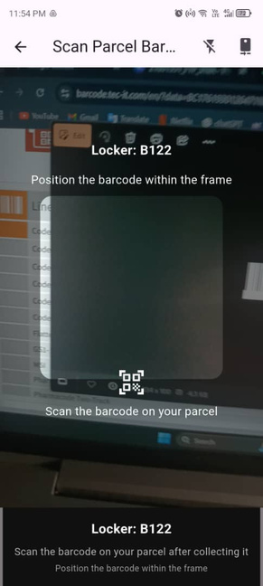
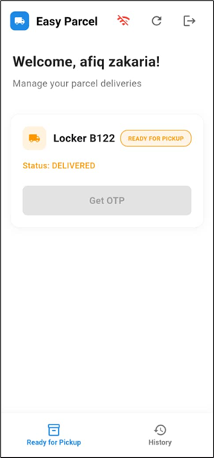
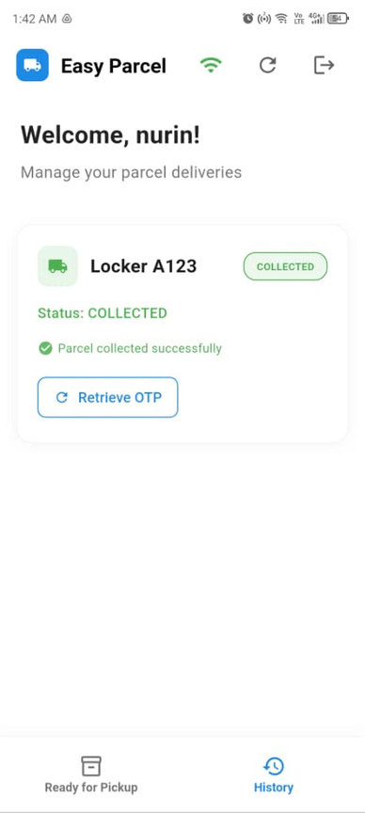
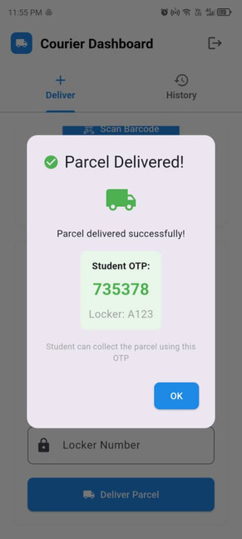
MOBILE APPLICATION
4
Student Homescreen
4
Student Homescreen:
History Tab
Real-Time Dashboard: Instantly displays incoming parcels categorized as "Ready for Pickup" with their current status (e.g., "DELIVERED").
Status Update:
Once a parcel is scanned and collected, it automatically moves from the active list to this history log with a "Collected" status.
Essential Details: Clearly identifies the assigned storage unit (e.g., "Locker B122") so the student knows exactly where to go.
Confirmation Process:
Students scan the parcel's label to verify they have collected the correct item, which updates the system status.
Secure Retrieval: Features a "Get OTP" button that retrieves a unique One-Time Password, allowing the student to securely unlock the specific locker.
OTP Retrieved

Slide 25
CONCLUSION & RECOMMENDATIONS

Slide 26





CONCLUSION
Successful System Integration
ESP32, Supabase, and Flutter were combined to create a secure, automated parcel system.
Reliable System Performance
The app and hardware worked smoothly for parcel registration, OTP verification, and locker access.
EASY
PARCEL
Positive User Experience
User testing showed the system was easy to use and reduced manual handling.
Objectives Achieved & Sustainable
All goals were met, supporting digital transformation aligned with SDG 11: Sustainable Cities and Communities

Slide 27
RECOMMENDATIONS
FUTURE IMPROVEMENTS
Strengthen Network Connectivity
Add Administrative Monitoring Features
01
Use more reliable options such as stable Wi-Fi, Ethernet, or GSM to ensure uninterrupted system operation.
02
Include tools like real-time usage tracking, locker analytics, and maintenance alerts for better system management.
Develop a Multi-Locker Hardware Design
Expand Testing and Future Scalability
03
04
Upgrade the prototype into multiple compartments to support larger user groups and real deployment.
Test with a wider demographic and explore expansion for institutional or commercial applications.

Slide 28
CLOSING
THANK YOU

